Slide 1
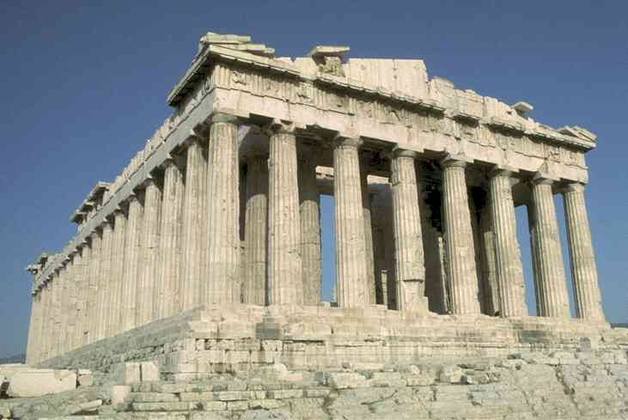
Classical Greece

Slide 2
Classical Period 500-339 BC
"Classical" means:
Standard against which others are judged or evaluated
Greatest
Enduring
Stylistic form (music, art, etc)
Stylistic period (e.g. after Baroque)
Golden age of a civilization

Slide 3
Classical Period or The Golden Age of Greece
Centered in Athens
Began
Revolt of Greeks in Ionia (coast of Asia) against the Persians
Eventual defeat of the Persians
Battles of Thermopylae and Marathon
Athens expansionism and colonization
Delian League
Peloponnesian War
Between Athens and Sparta/Corinth
Lasted 27 years and was won by Sparta/Corinth
Pericles
"Ideal" ruler of Athens
Builder of Acropolis
Used money from the Delian League for city improvements
Is creativity adversely affected by war?

Slide 4
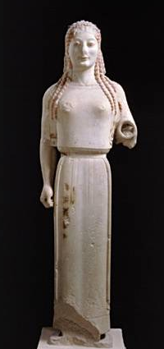
Daily Life
Population:300,000
Adult Males: 50,000
Women:
Not able to participate in government
Protected by law
Seemed to be "generic"
Slaves:
Did menial work
Foreigners

Slide 5
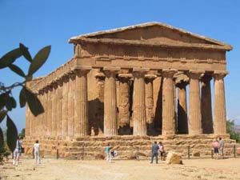
Daily Life
Greeks had few material possessions
Houses were simple
Food was simple
Religion was important
Common temple rituals
Seeking favor of the gods
Loyalty in worshiping gods of the polis
Belief in a single God was advocated by a few (disloyal?)

Slide 6
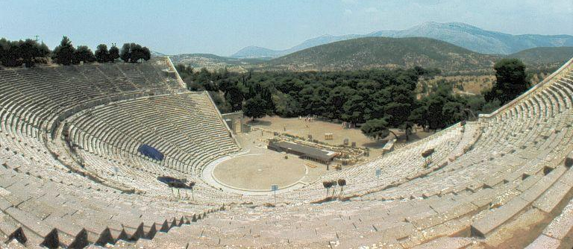
Drama
Festivals of Dionysus (God of Wine)
Playwrights submit 4 plays for competition
Method of presentation
Actors with masks
Chorus
Acoustics
Reserved seats
Dry seats
Mechanics
Themes
Trojan war characters and their descendents
Ethics from Heroic period

Slide 7
Drama
Tragedy
Genre invented by Thespis (543 BC)
The most common of the genrés
Of about 1000 written, only 31 remain – all by Aeschylus, Sophocles, and Euripides
The change that occurs due to difficulty
Not about a person dying
Aristotle’s Poetics describes ideal tragedy
Tragic defect—weakness in character that leads to the difficulties or that must be overcome

Slide 8
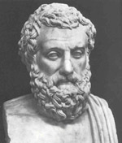
Drama
Aeschylus (525-456 BC)
Aware of human weakness
Discusses pain and suffering
In the end, justice triumphs
Oresteia trilogy about the House of Atria
Agamemnon
The Libation Bearers
The Eumenides (The Furies)

Slide 9
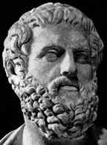
Drama
Sophocles (496-406 BC)
Friend of Pericles
Great prestige and wealth
Wrote 123 plays, but only 7 exist
Sophoclean tragic heroes
Have tragic defects
Are likeable and we feel sorry for them
Introduced two-actor interaction
Conflict:
Tradition and loyalty to king (Antigone)
Good intentions and fate (Oedipus the King)

Slide 10
Drama: Sophocles
Oedipus the King (Oedipus Rex)
Epitome of Greek tragedy
Fate has powerful hold on humans
Before his birth, destined to kill father and marry mother (revealed by oracle)
Conflict between fate and attempts to control destiny
Inherent moral outrage of marrying mother and/or killing father

Slide 11
Drama: Sophocles
Antigone
Thebes attacked by Polynices (son of Oedipus)
Polynices was fighting his brother
Both were killed in battle
Creon, the new king, forbade Polynices’ burial
Antigone, Polynices sister, buried him
Antigone was condemned to death
Creon’s son was engaged to Antigone
Creon revoked his penalty, but only after Antigone and Creon's son had committed suicide

Slide 12
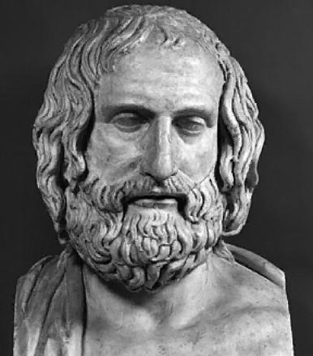
Drama
Euripedes (484-406 BC)
Expressed disillusion because of the war
Acknowledged powers of gods in fate, but did not respect them
Characters pushed to the limits of endurance
Deep hatred for war

Slide 13
Drama: Euripedes
Medea
Barbarian princess (on the coast of the Black Sea)
Helped Jason find the golden fleece against her father's wishes
They married and had two sons
Medea was ostracized for marrying foreigner and had to flee with Jason to Argos (in Greece)
Jason later married a younger woman
Medea sent magic robe to the bride causing the bride to burn to death
In further retribution against Jason, Medea also killed her two sons

Slide 14
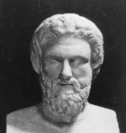
Drama
Aristophanes (450-385 BC)
Father of Greek comedy
This genré ends happily
It is not necessarily funny
Theme—futility of war
The Birds
Lysistrata
Poked fun directly at Sophecles and Aeschylus
Creative Project: Play about Aristophanes in the BYU library who meets a young woman who agrees to write a play in which he can demonstrate his superiority to other Greek playwrights

Slide 15
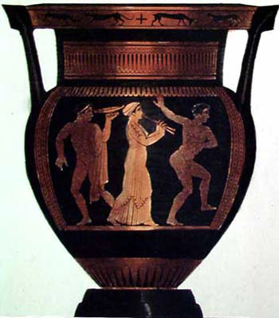
Music
Plato believed in ethos
The power of music to influence people’s lives
Music molded the soul
Musical scales (Pythagoras)
Role in Greek dramas
Role in development of Opera
Instruments: Lyre, Cymbal, Tambourine, Pipe

Slide 16
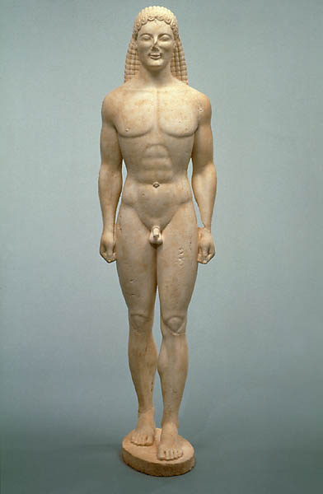
Art
Pre-classical
Simple pottery
Geometric designs
Migration to human forms (perfect symmetry)
Sculpture-generalized to be symbolic of all humans
Relation to Forms
Generic
Without dramatic expression
Lacked realism

Slide 17
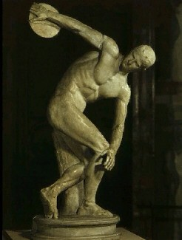
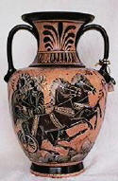
Art
Classical Sculpture
Great advances
Technical ability
Reality
Perception of inner qualities
Greek principles important
Exact proportion—Golden mean
Phidias—greatest Greek sculptor
Parthenon, Temples in Olympia
Vases
Why painted?
My Greek vase

Slide 18
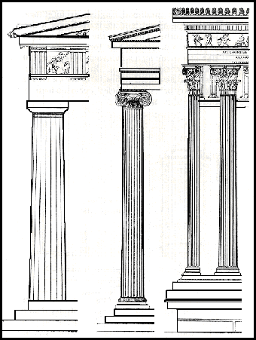
Architecture
Initial temples were simple and rectangular
Two columns at entrance
Columns around perimeter (peripteral)
Column styles
Doric Ionic Corinthian

Slide 19
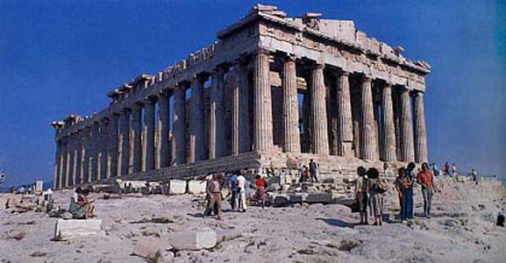
Architecture The Acropolis: Parthenon

Slide 20
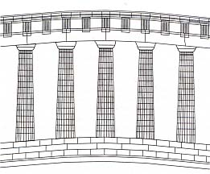
Architecture
The Parthenon
Erected by Pericles as a tribute to Athena
Funding from Delian League
Phidias was sculptor in charge
Combined Doric columns with Ionic features
Columns are thinner at the top
Tip towards each other
Corners thicker
Floor is convex

Slide 21
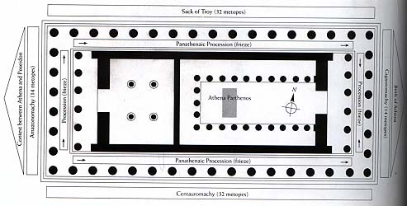
Architecture
The Parthenon (cont.)
Single main room-statue of the goddess
Later classical period lacked innovation and boldness of earlier period

Slide 22
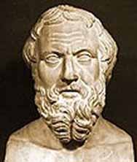
History
Herodotus (484-420 BC)
Father of History
Tried to record coherent history
Traveled widely
Books called Researches
Made judgments based on humanness
Most writing were about Persian wars

Slide 23
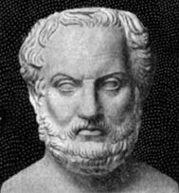
History
Thucydides (470-405 BC)
Prominent soldier/historian
Removed from command for failure in battle
Inserted important speeches into history
Criticized because he could not have heard all these speeches
His history ended before the war
Probably died in war

Slide 24
“Leisure is the basis of culture”
--Aristotle

Slide 25
Thank You

Slide 26
“The psychological conditions which make a society or an epoch creative and consistently original have been little studied, but it seems likely that social conditions analogous to those seen in individual creativity are important. Freedom of expression and movement, lack of fear of dissent and contradiction, a willingness to break with custom, a spirit of play as well as of dedication to work, purpose on a grand scale; these are some of the attributes which a creative social entity, whether vast or tiny, can be expected to have.”
— Frank Barron, Institute of Personality Assessment and Research, University of California, Berkeley

Slide 27
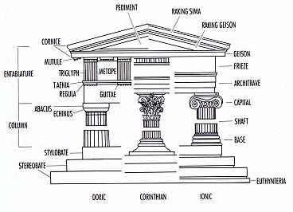
Architecture Nomenclature

Slide 28
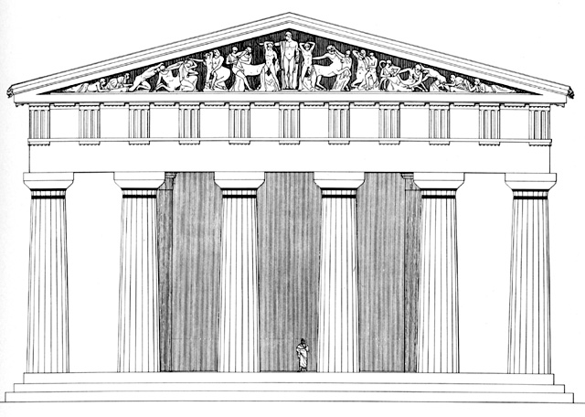
Architecture
Proportion was a major design factor
Temple of Zeus at Olympia

Slide 29
This powerpoint was kindly donated to www.worldofteaching.com
http://www.worldofteaching.com is home to over a thousand powerpoints submitted by teachers. This is a completely free site and requires no registration. Please visit and I hope it will help in your teaching.

